Slide 1
UrbanQuest: Adaptive Narrative Scavenger Hunts with LLMs
Submitted by:
Huaye Wei
Supervisor:
DR . ENKHBOLD NYAMSUREN

Slide 2
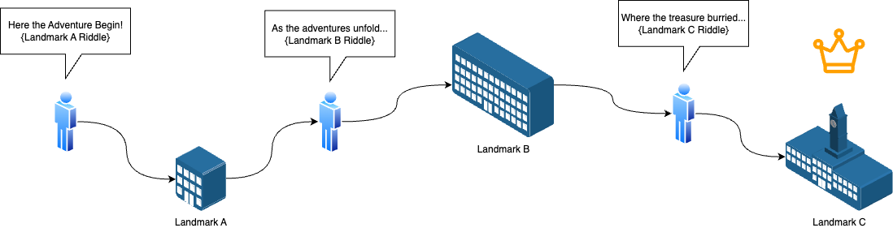
What is scavenger hunt?
The Adventures of Tom Sawyer - Mark Twain

Slide 3
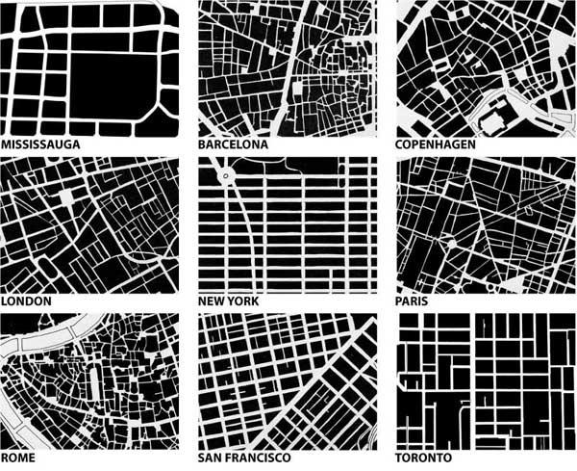
Background
Navigation Tech (GPS): Efficience over Experiences
Urban Narratives: Isolated over Connected
Modern Transportation: Mobile over Walking

Slide 4
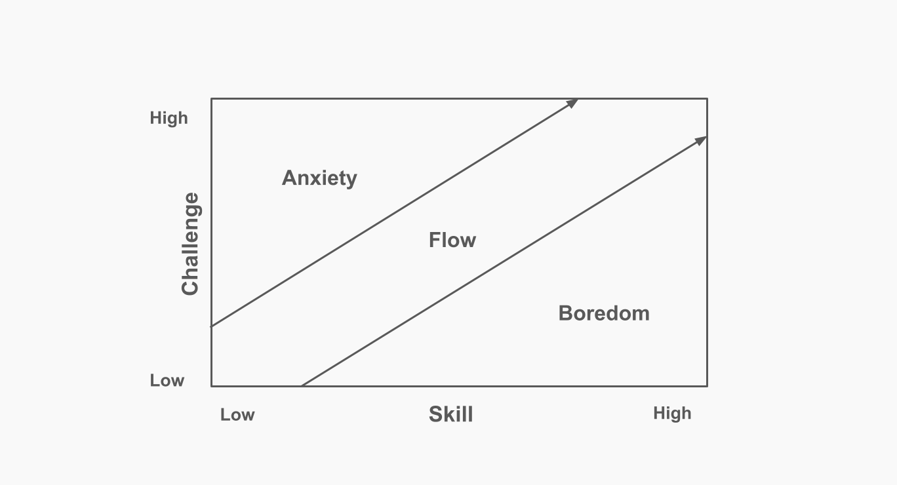
3 Elements of Scavenger Hunt
Environment: Landmark Knowledgebase
Riddle Difficulty: Adaptive Difficulty
Riddle Narration: Riddle Coherence
The Flow(1990), p.74 - Mihaly Csikszentmihalyi

Slide 5
Solution
Environment: Retrieval-Augmented Generation (RAG)
Riddle Difficulty: High-Speed High-Stakes (HSHS)
Riddle Narration: Context-aware Prompt Engineering
Player-Landmark Interaction

Slide 6
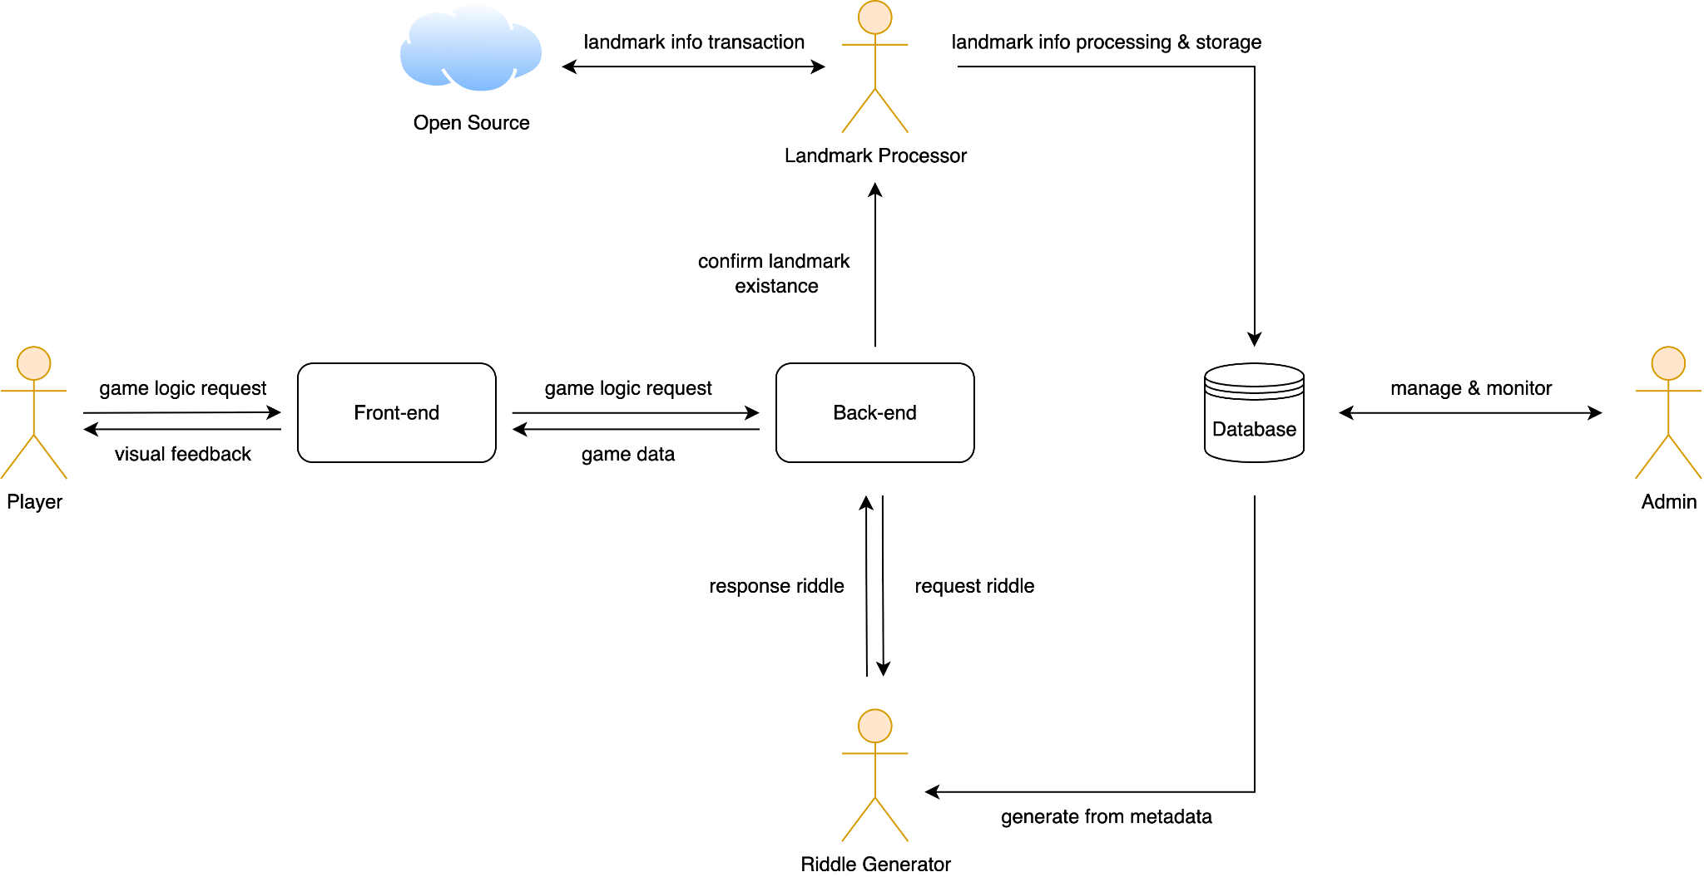
Solution - System Roles
Role Diagram

Slide 7
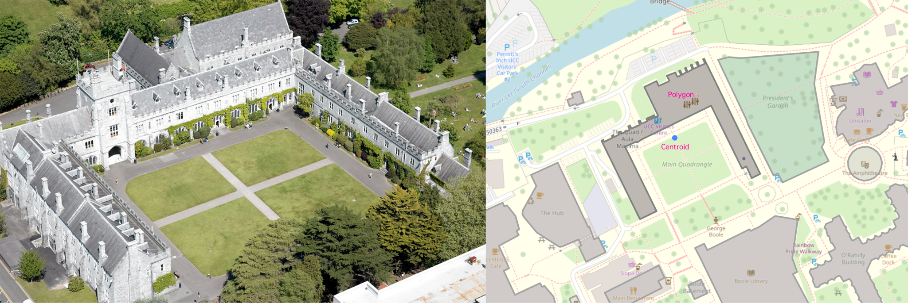
Landmark Processor
Landmark Spatial-data: centroid coordinates, parameters
Landmark Meta-data: history, background, architecture, significance…
UCC Quad. Left: Aerial image; Right: mapping representation.

Slide 8
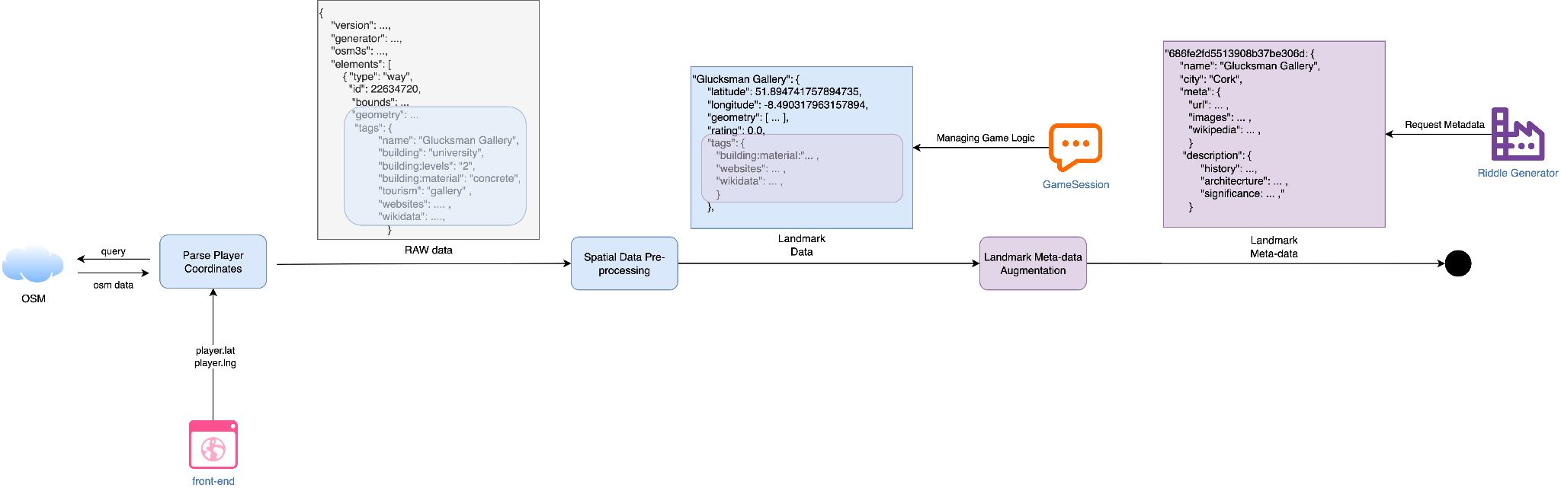
Retrieval-Augmented Generation (RAG)
Landmark Preprocessing Pipeline

Slide 9
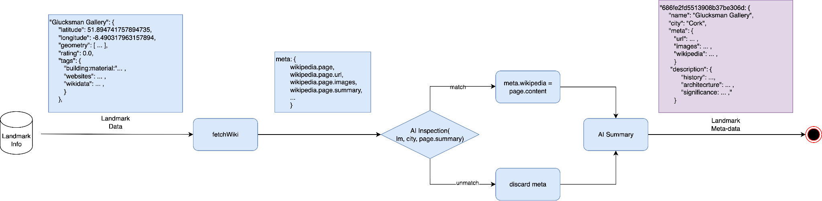
Landmark Data Augmentation
Landmark Meta-data Augmentation

Slide 10
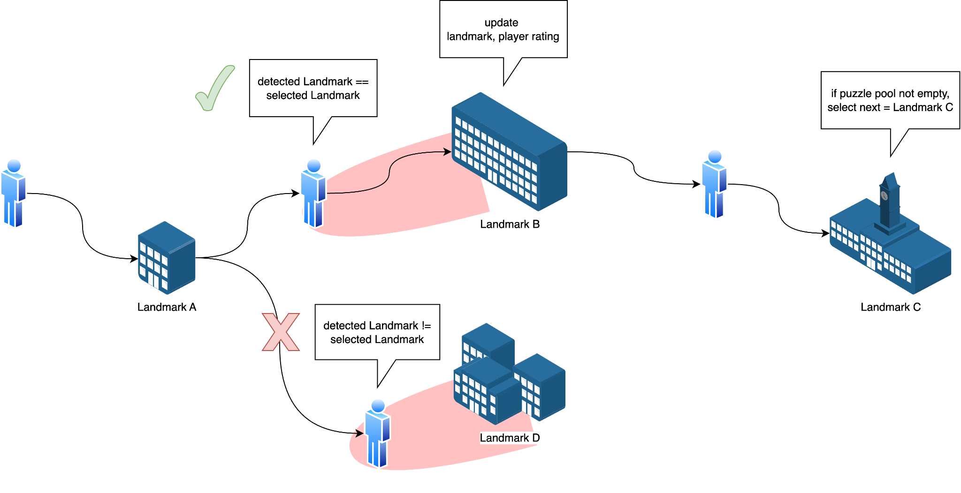
Main Logic (Backend)
Execute Main Logic
Modeling player-landmark Interaction
Physical Interaction
Rating-level Update (HSHS)
Issuing Puzzle Generation Pipeline request
Gameplay Logic

Slide 11
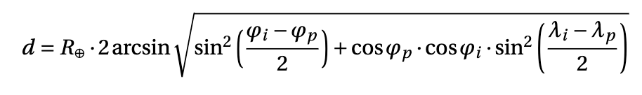
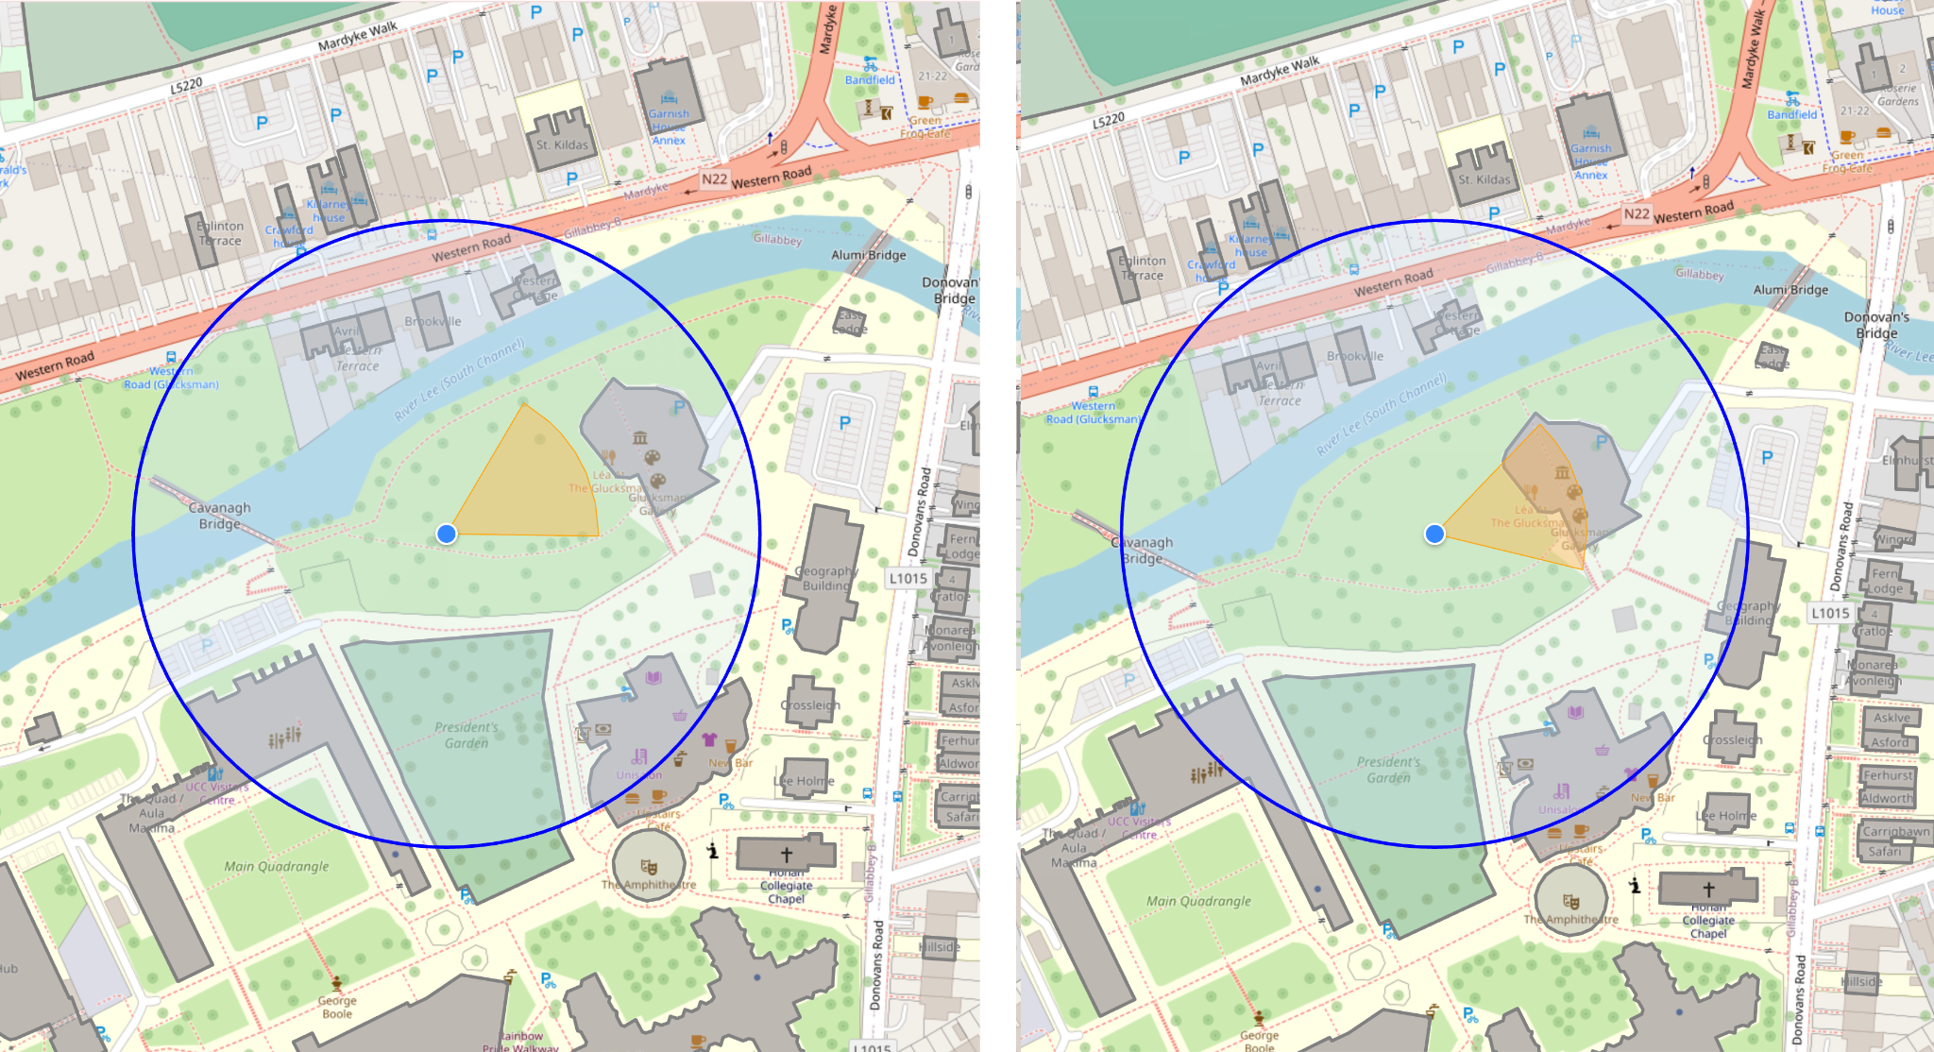
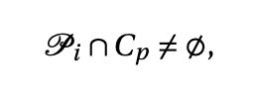
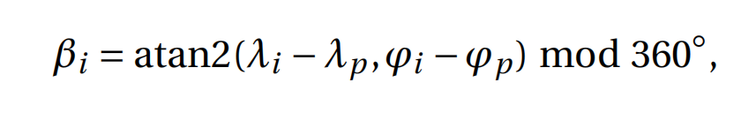
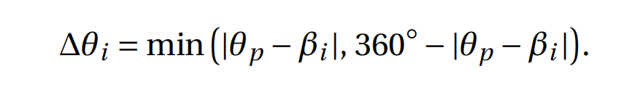
Utilities
Haversine Distance(Earth Curvature)
View Cone Intersection
Angular Alignment
Bearing from p to L_i
Minimum Angular Seperation
Left: Undetected Right:Detected

Slide 12
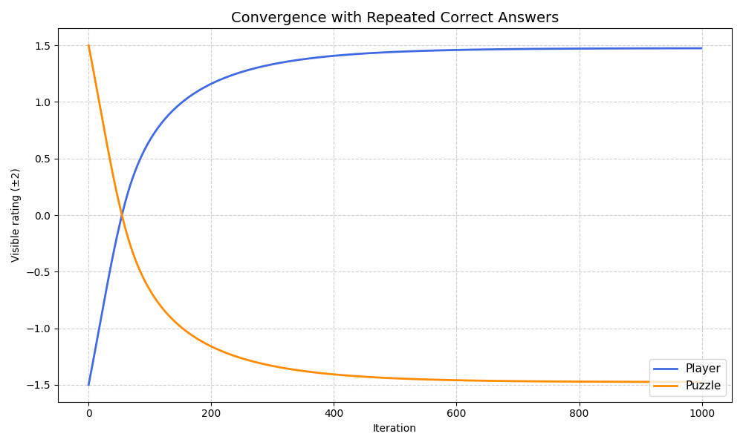
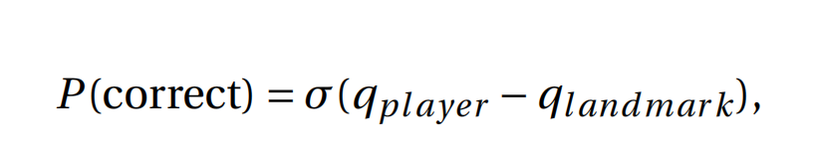
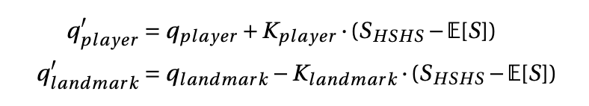
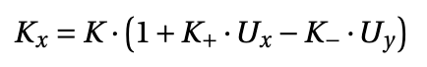
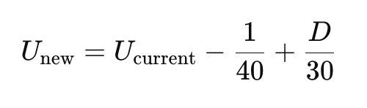
Difficult Rating Modeling
Probability of Success:
Elo-HSHS Framework:
Uncertainty(U)-Aware Learning Rate (K)
Player/Landmark Rating Convergence

Slide 13
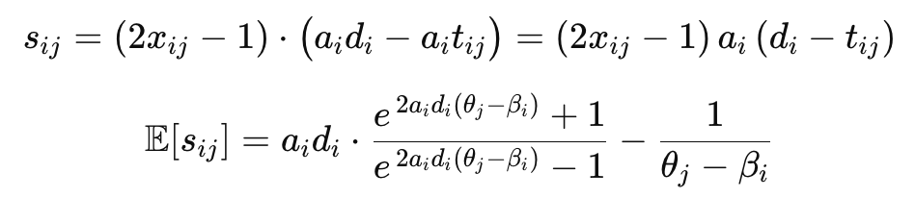
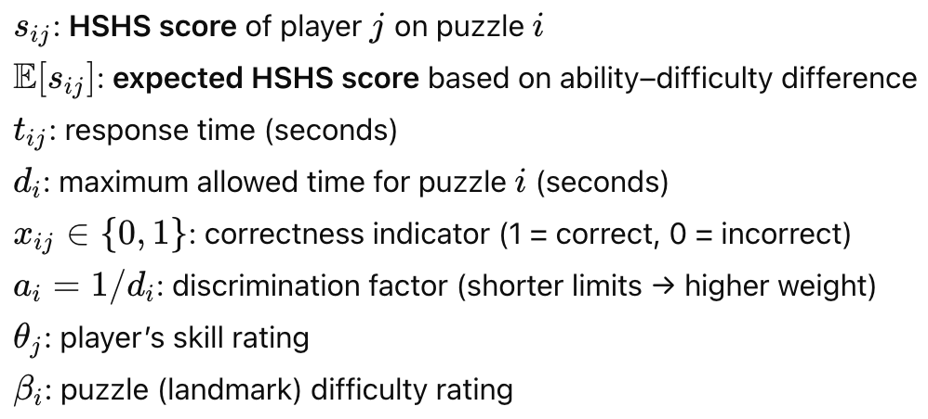
High-Speed High-Stakes (HSHS)
Math Garden System
[Klinkenberg, Straatemeier, and van der Maas 2011]
Player/Landmark Rating Convergence

Slide 14
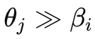
High-Speed High-Stakes (HSHS)
HSHS
Correct + fast -> high positive score
Correct + slow -> low positive score
Incorrect -> negative score
Expectation
Expected score -> maximum
Otherwise, Expected score -> minimum
Exponential term ensures smooth transition
Player/Landmark Rating Convergence

Slide 15
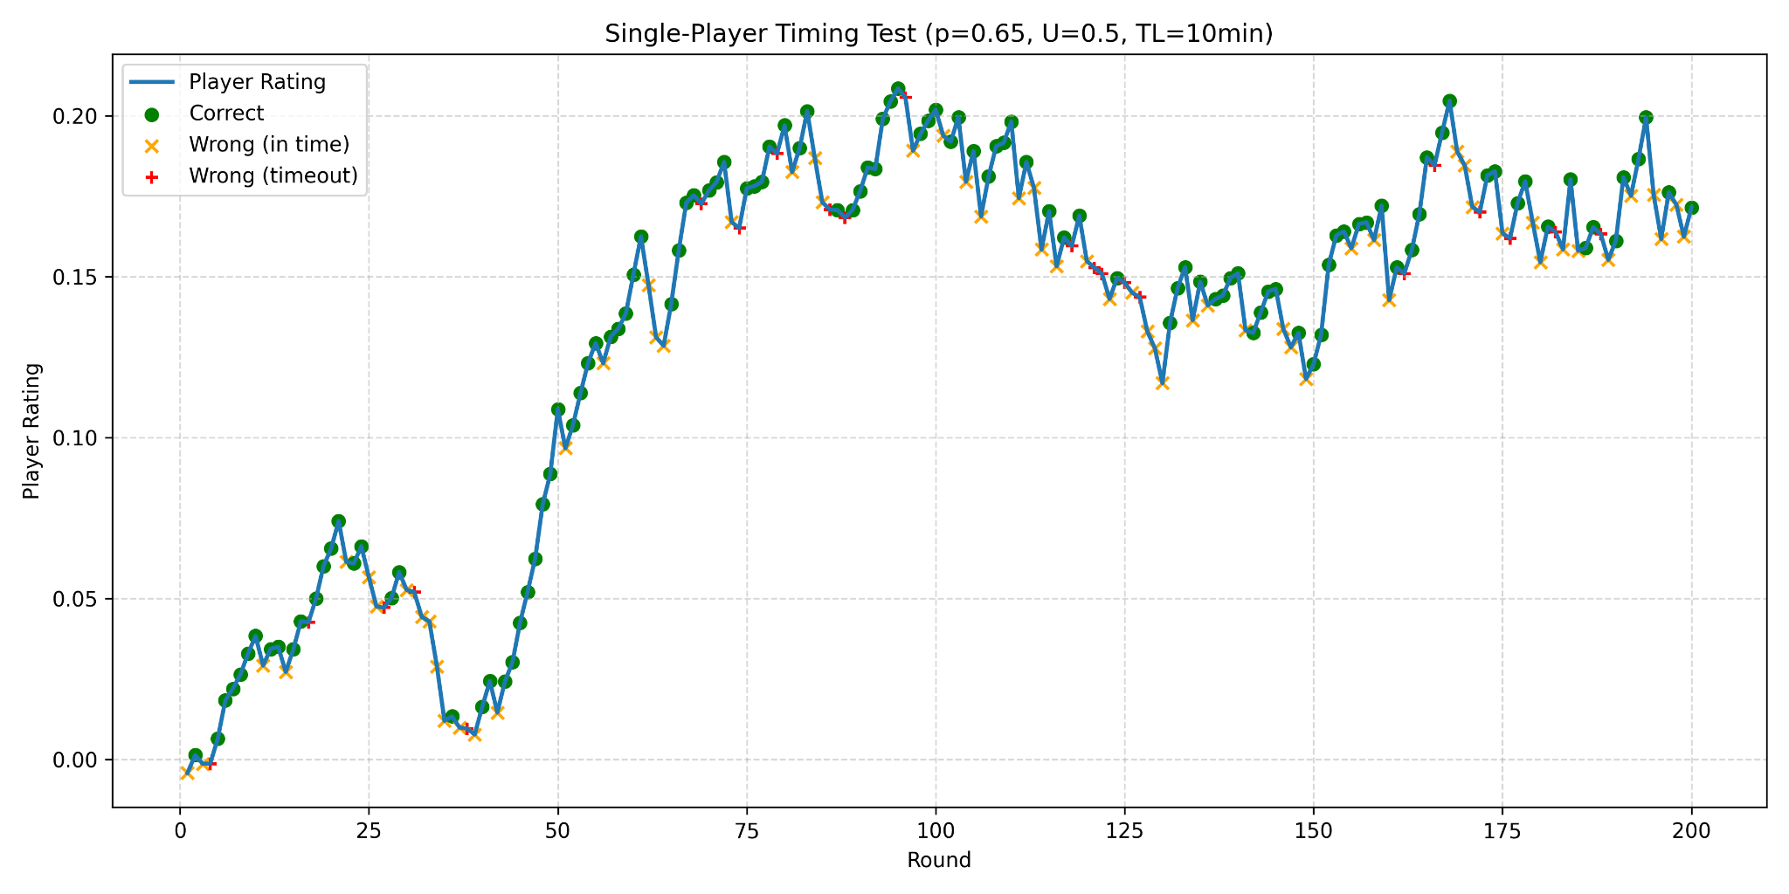
Difficult Rating Mapping
Normal Player Simulation

Slide 16
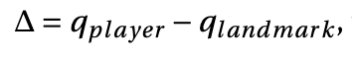
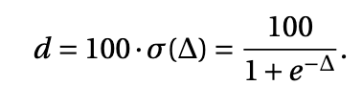
Difficult Rating Mapping
P/L Rating Difference
Difficult Rating Mapping
Player/Landmark Rating Convergence

Slide 17
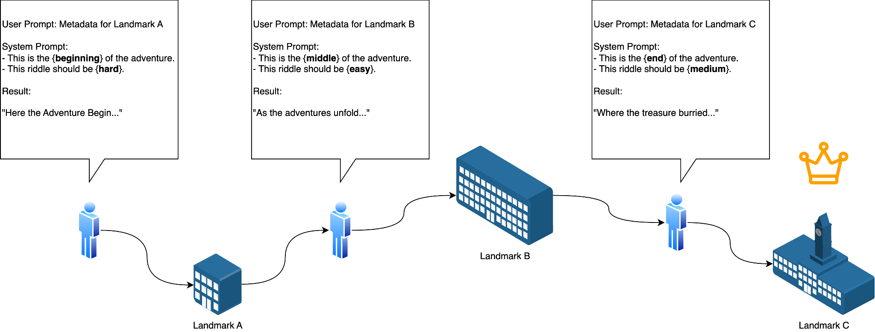
Riddle Generation Pipeline

Slide 18
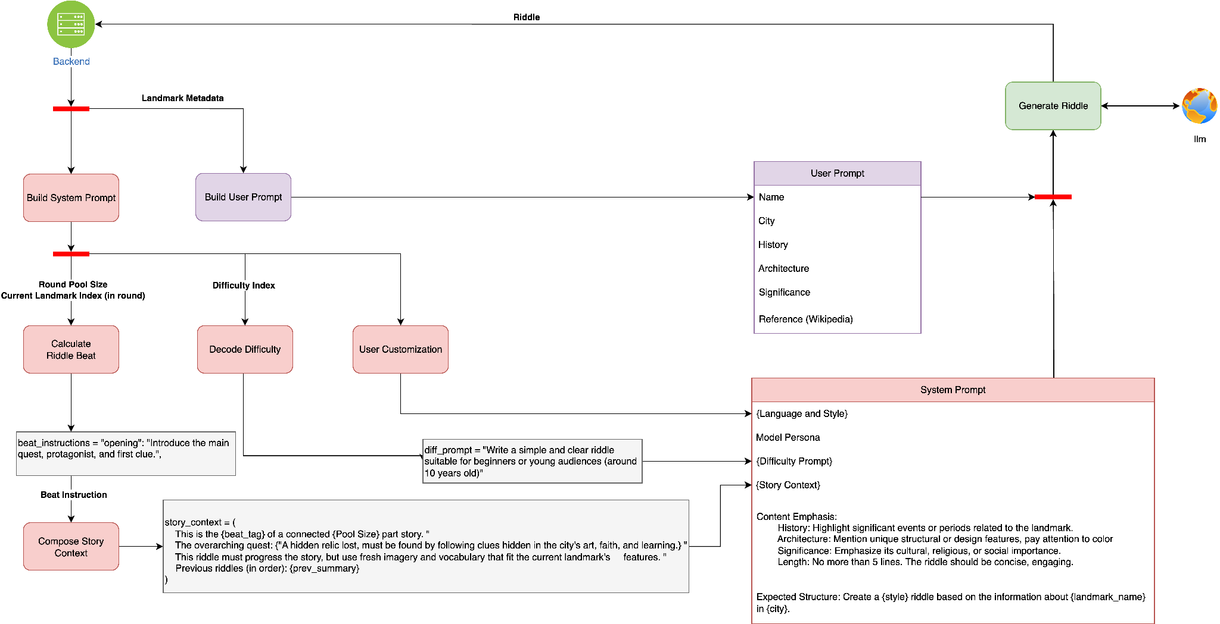
Pipeline Overview

Slide 19
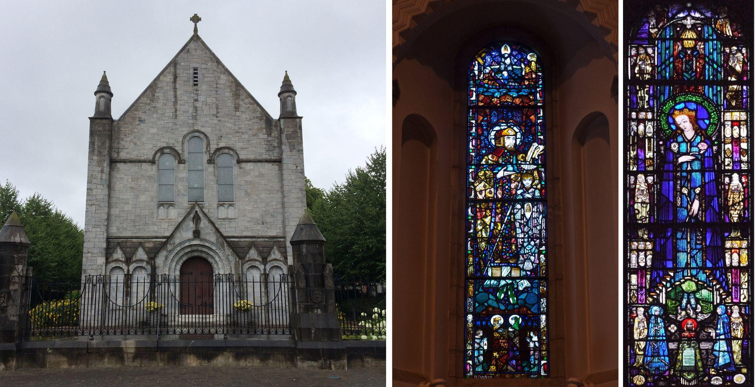
Example Output
Within stone walls where learning prays,
A chapel born in Gaelic days.
Its windows glow in ruby flame,
Each tile recalls a sacred name.
What house of worship guards this place?
Honan Collegiate Chapel, Cork — reference image for riddle prompt generation

Slide 20
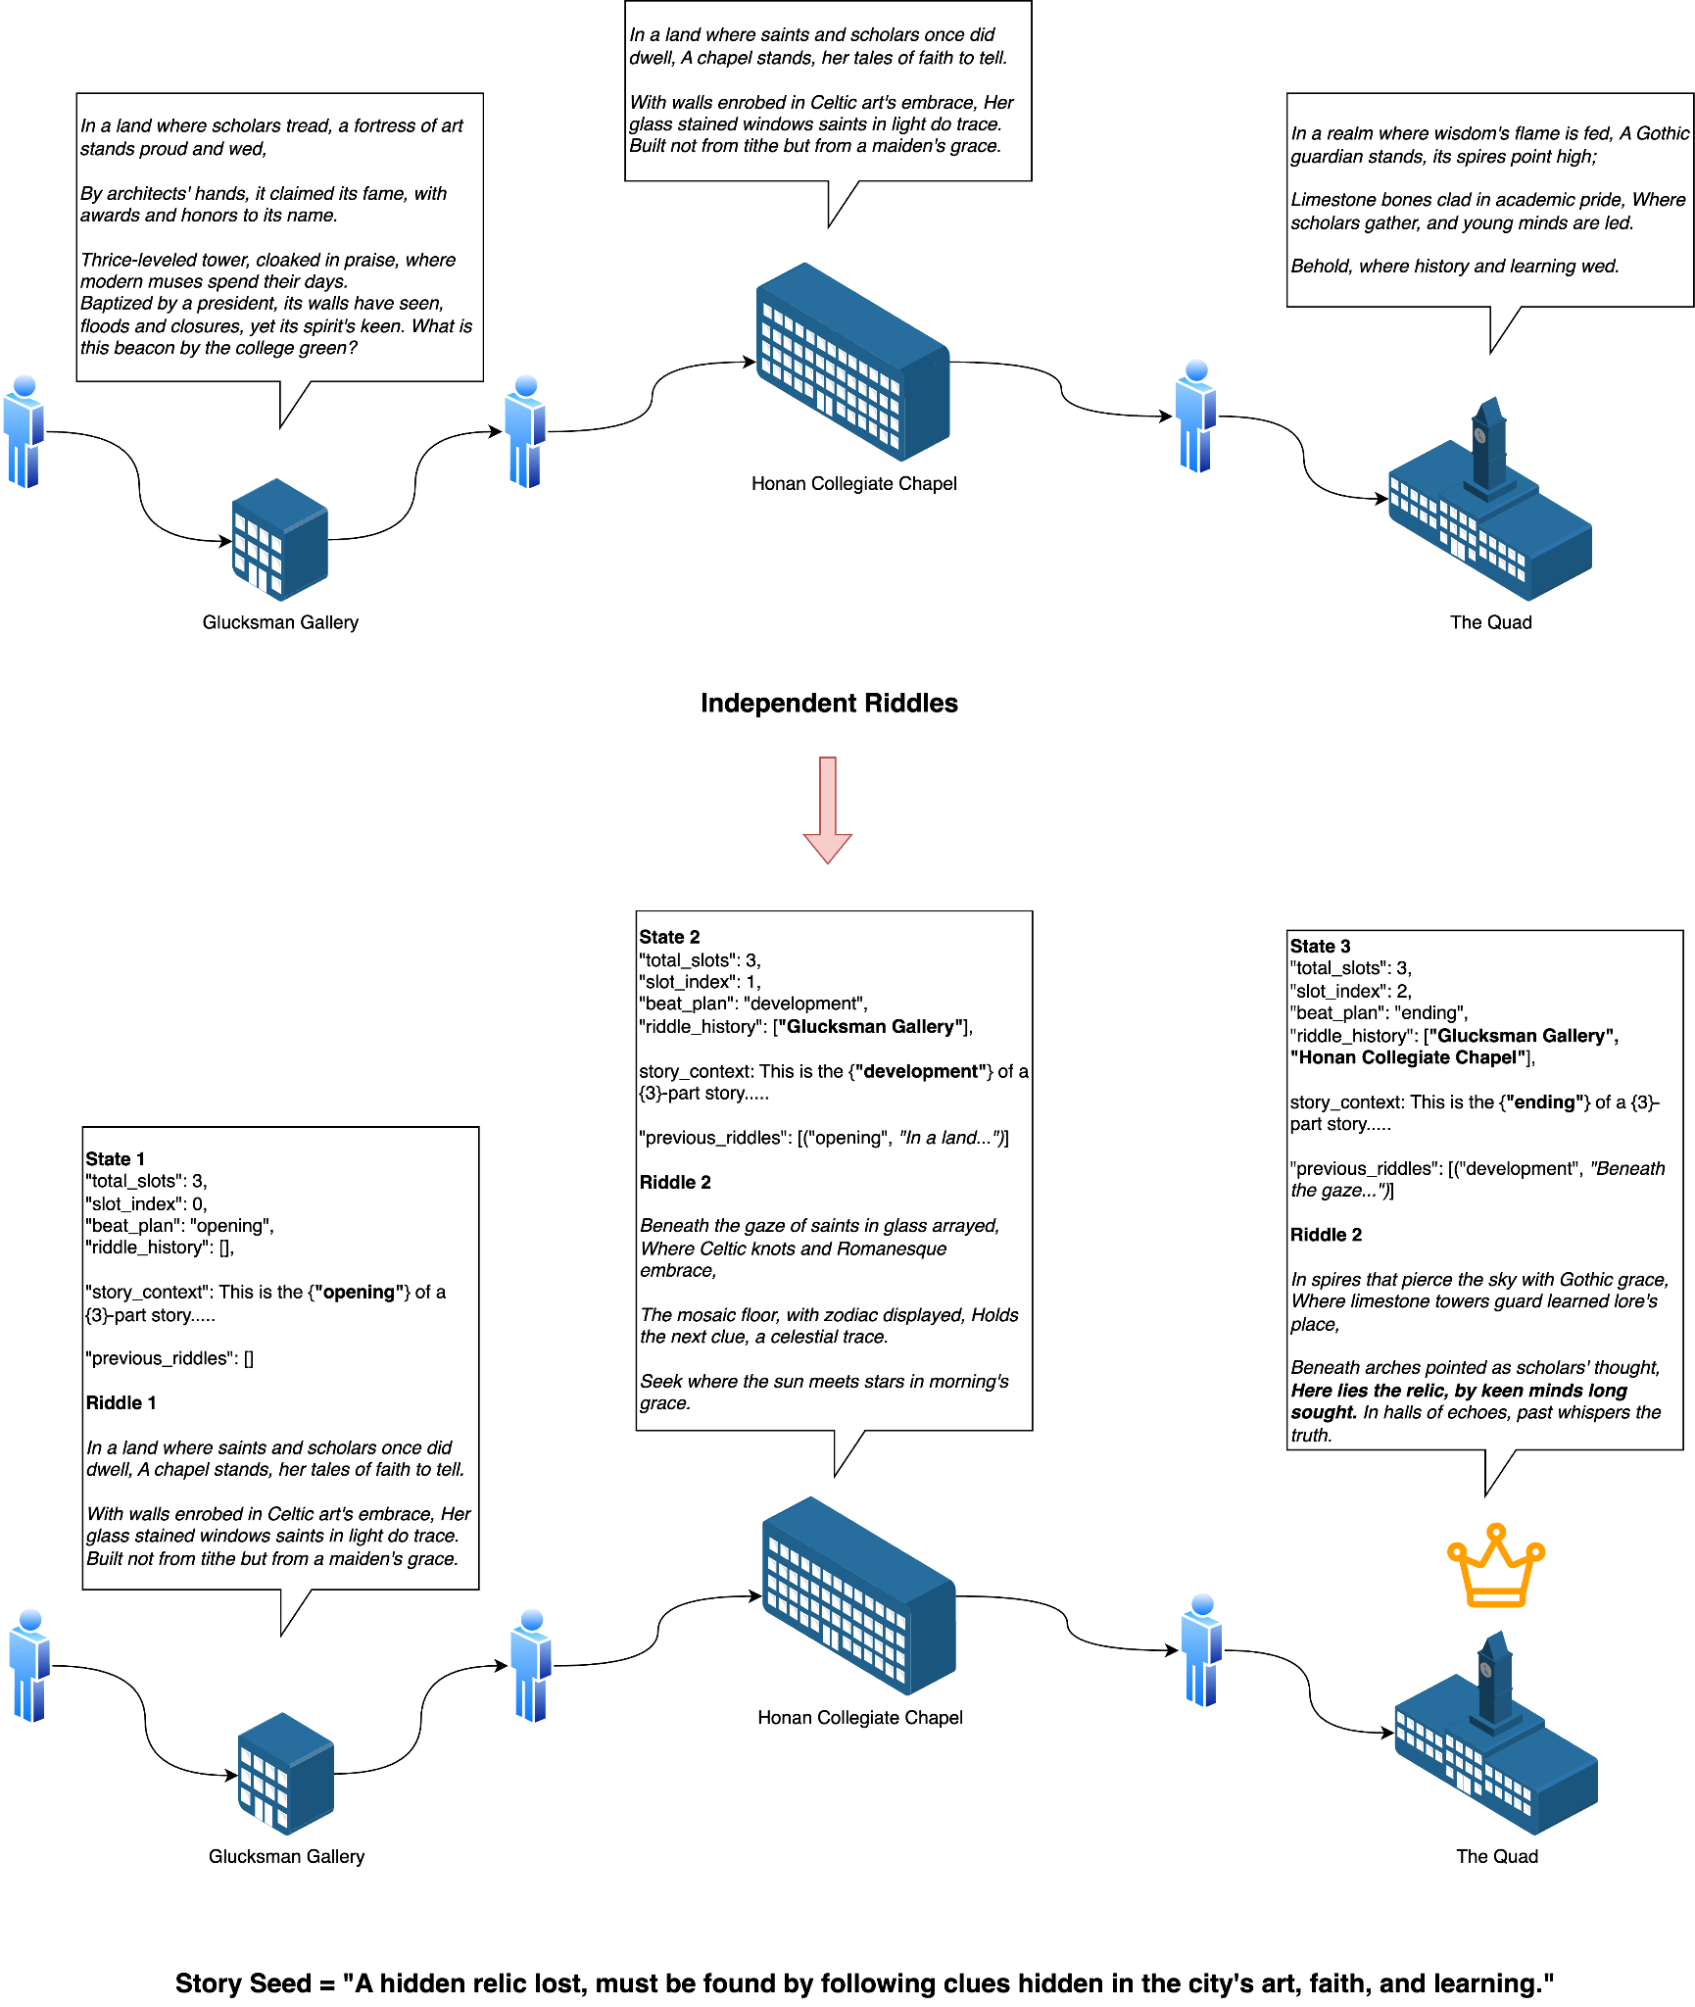
Context-aware Riddle Generation

Slide 21
Result

Slide 22
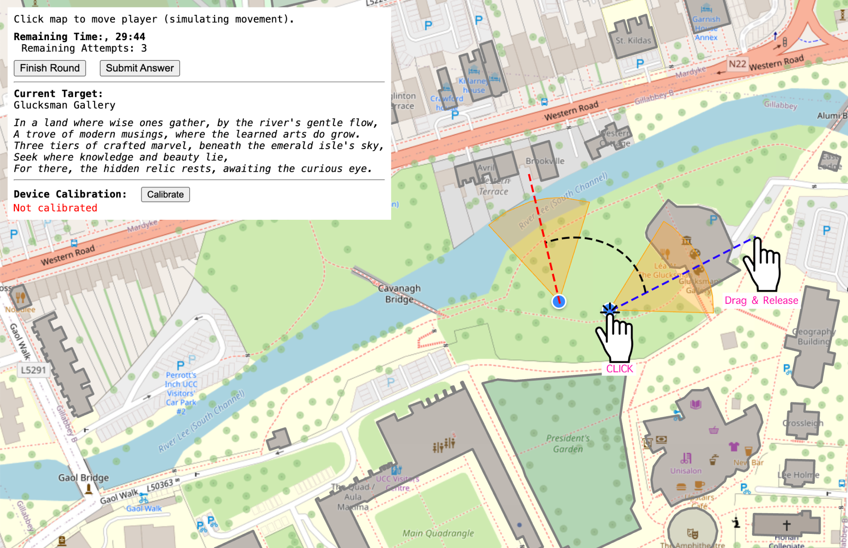
Player Movement Modeling
Test Player Teleportation
Actual Player Tracking
Click-drag-release Teleportation

Slide 23
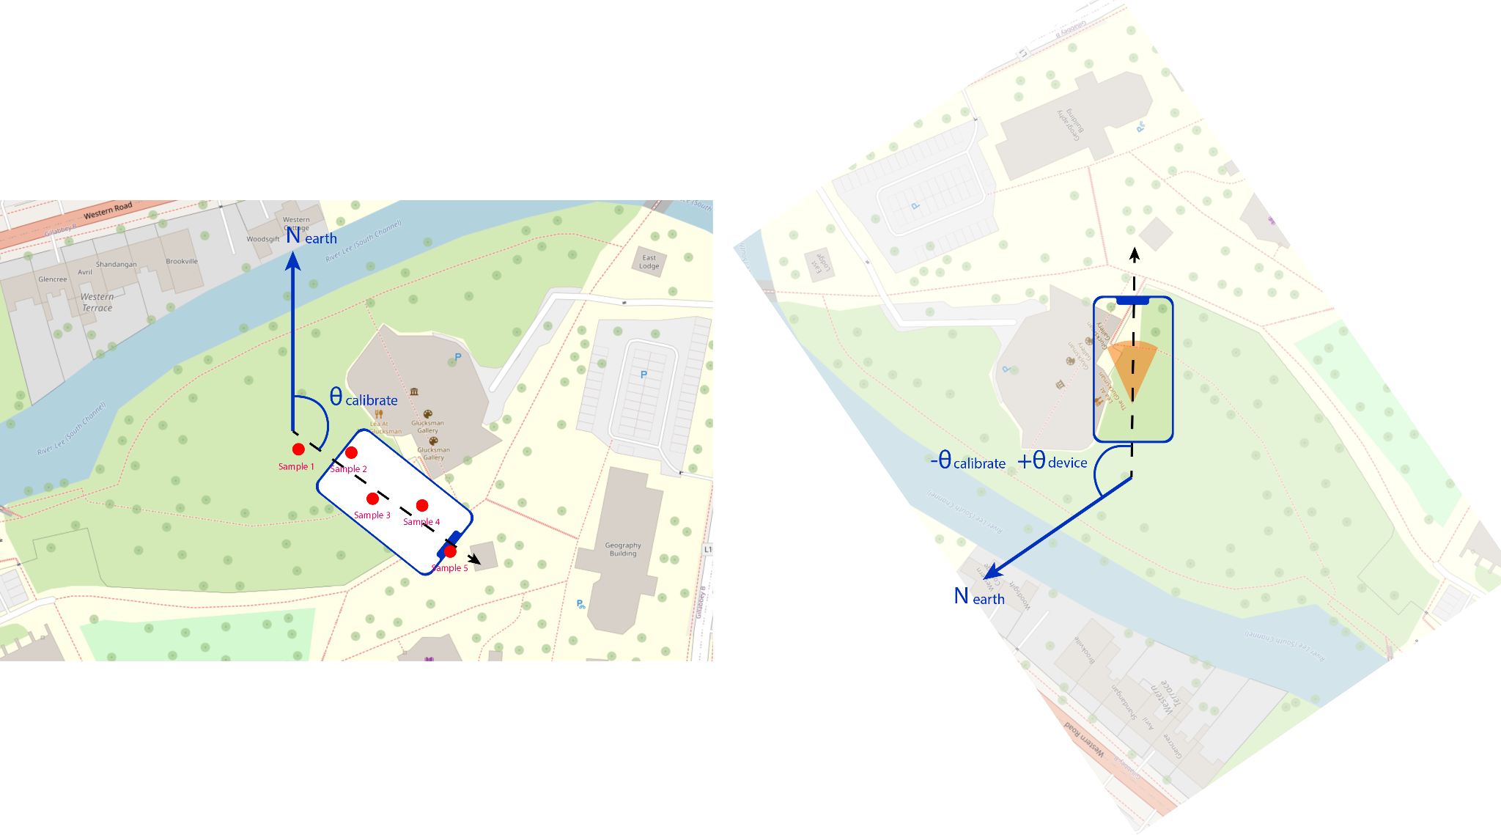
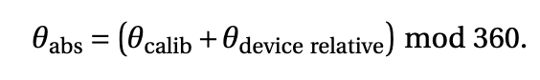
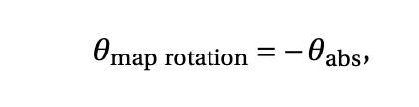
Player Tracking Calibration
Browser: navigator.geolocation interface
Wi-Fi positioning, cell tower triangulation, and low-precision sensor estimates
First Person Tracking
Calibration and Real-time Tracking

Slide 24
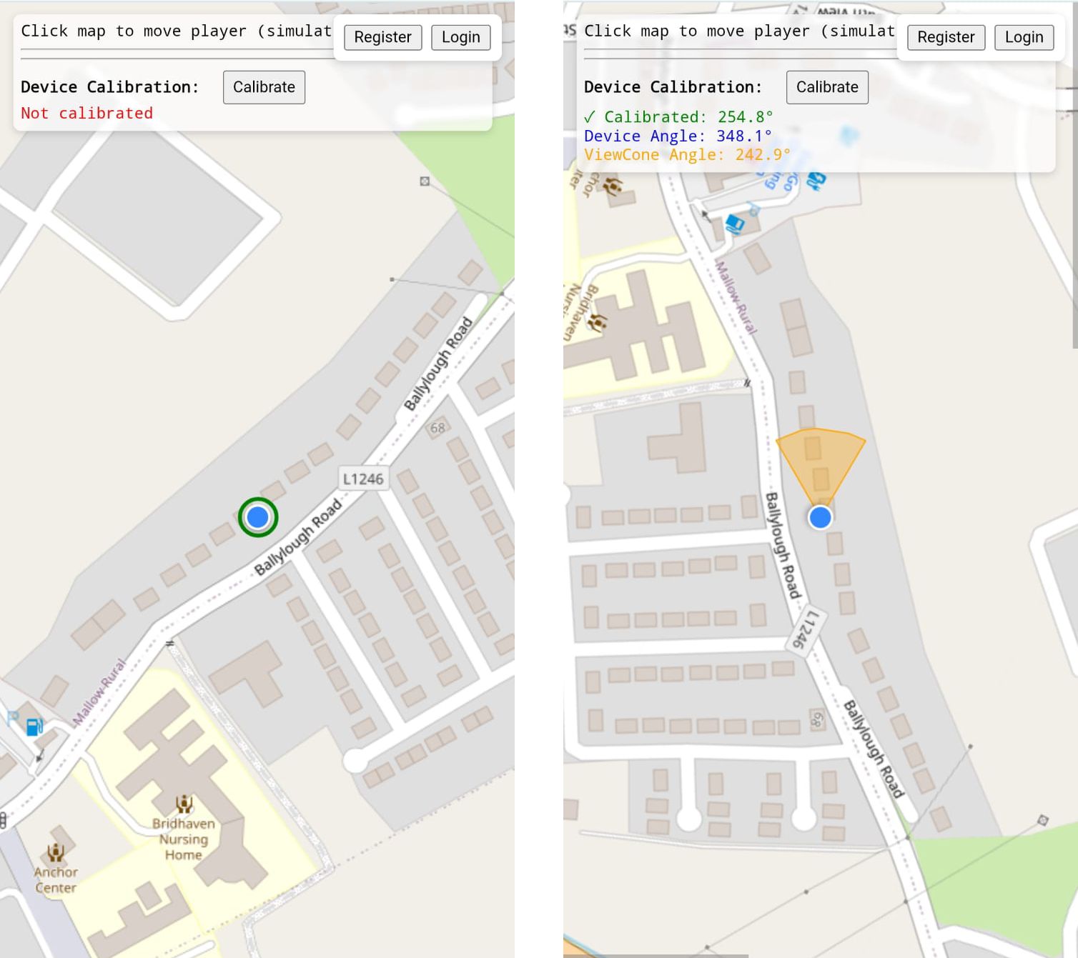
Real-time Movement Tracking
Browser: navigator.geolocation interface
Wi-Fi positioning, cell tower triangulation, and low-precision sensor estimates
First Person Tracking
Real-time Tracking

Slide 25
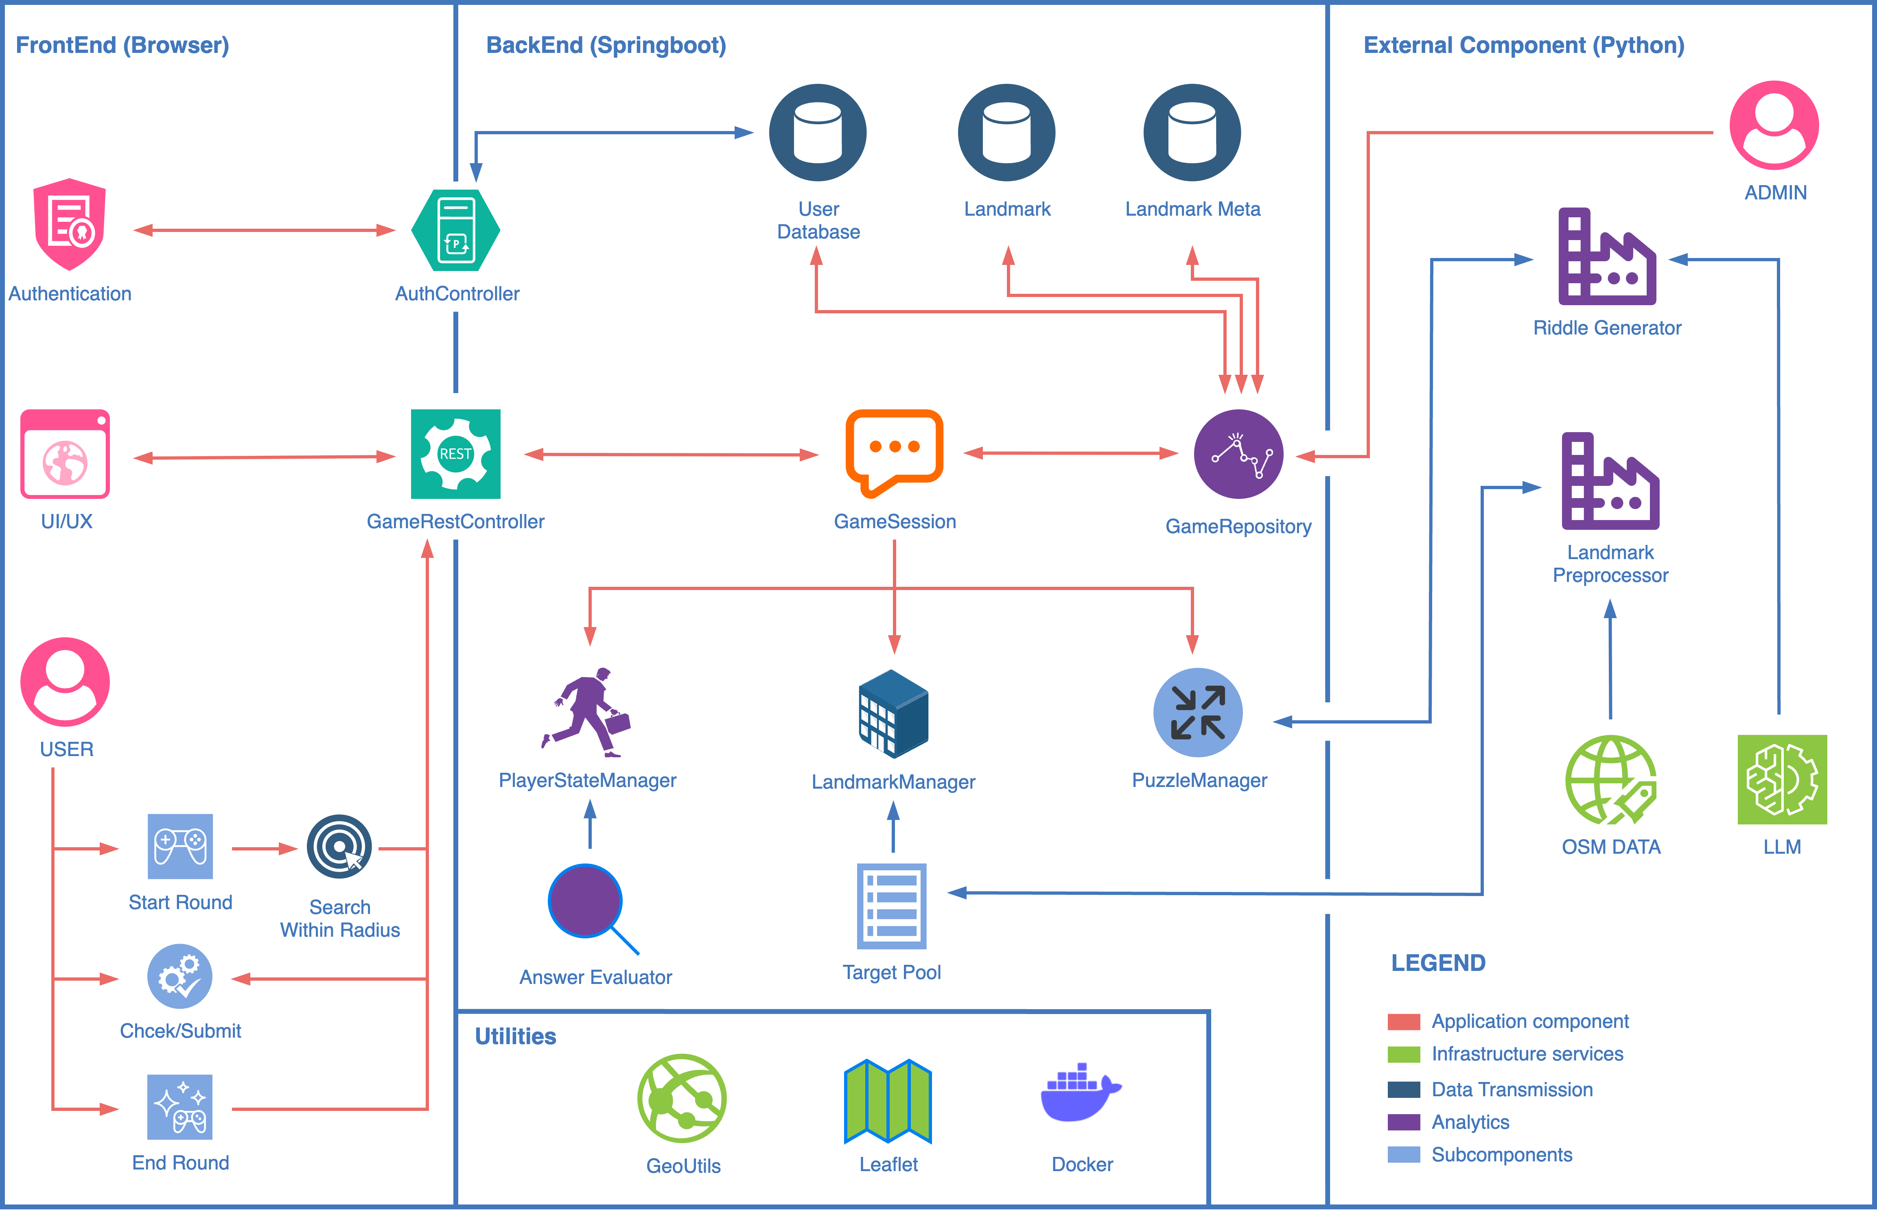
Architecture
Front-end: Javascript + Leaflet
Back-end: Spring-boot
Database: MongoDB
External Component: Python + Flask API
Software Components

Slide 26
Thank you !

